Slide 1


Insert company logo
Integrated Benefits, HR & Compliance

Slide 2

A Technology Solution For You and Your Employees
Employee Navigator is a modern benefits and HR platform, built to work hand-in-hand with your insurance broker.
By moving enrollment and benefits management online, Employee Navigator eliminates paperwork and gives you and your employees time back in the day. Since being founded in 2008, Employee Navigator has partnered with the nation’s top brokers to deliver an all-in-one system for benefits, onboarding, compliance, and more.
More than 180,000 companies and 15 million employees trust Employee Navigator to simplify HR and benefits administration.

Slide 3



Your Employees Will Love It
Employee Navigator helps your employees make smarter benefits decisions by putting all their benefits information at their fingertips.
Make better decisions
Conduct faster enrollments
Employees can complete a 100% digital enrollment.
Access Employee Navigator via web or mobile to view important benefit details year-round.
Unlock 24/7 access

Slide 4
“
Simple to use, easy to navigate and find what I need and lastly the integrations are very helpful.
- Emmanuel
Employee Navigator is very easy to use from setting up an account to the employees electing their benefits. It really encompasses everything needed to administer your benefits package.
- Chaunee
EN has helped streamline our enrollment process. Not only that, but our employees are also comfortable enough with the system to go in when they have a life event and make the changes without HR having to do the work.
- Angela
We love Employee Navigator! This system has been a "game changer" for our agency!
- Karen
I love the fact that you can use this platform to work with many different carriers with such ease. Their support team is amazing also.
- Louis
I love the end-user navigation. SO easy for employees to make their benefit elections. Being an admin HR user is also very easy. The customer support for premier users is 2nd to none.
- Melissa
The most helpful aspect of Employee Navigator has to be the intuitive enrollment flow for employees. On the back end, this system wouldn't be what it is without the robust reporting options that are available.
- John

Slide 5
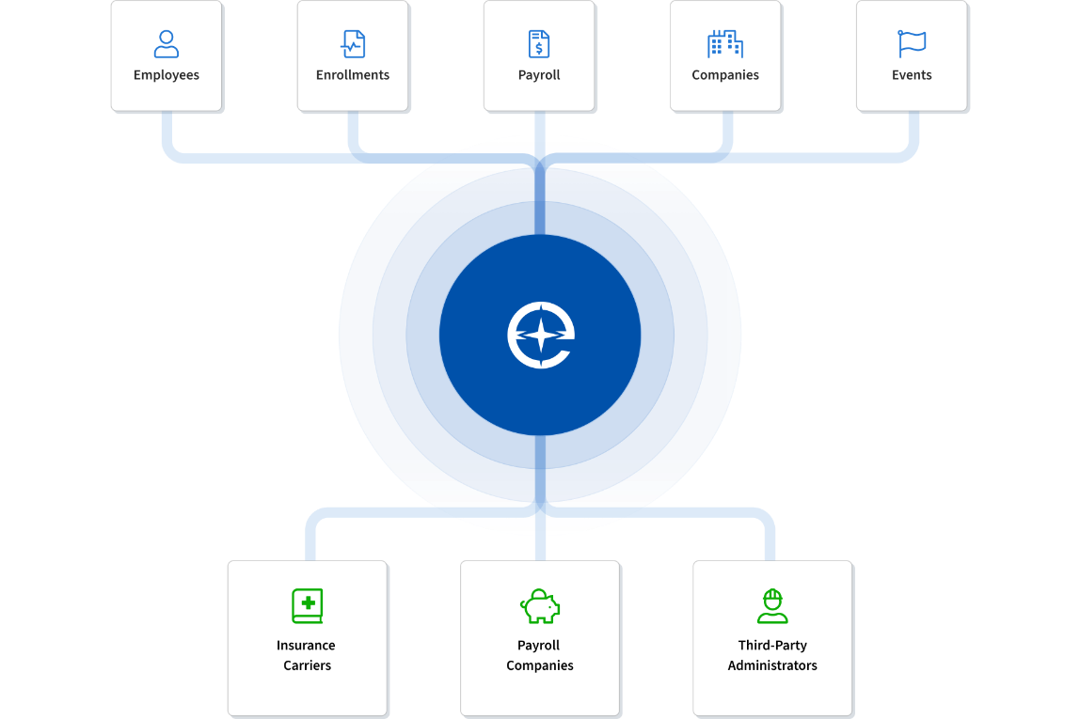
Employee Navigator’s Integrations
Say goodbye to manually processing enrollments and changes
Employee Navigator connects directly with your preferred insurance carriers, payroll providers, and TPAs to deliver a truly seamless digital experience.
Access the industry’s largest integration marketplace
With 500+ integrated partners, Employee Navigator offers unmatched connectivity for your business.
Reduce errors and eliminate manual work
Keep your data in sync automatically and gain peace of mind knowing everything updates accurately and on time.

Slide 6
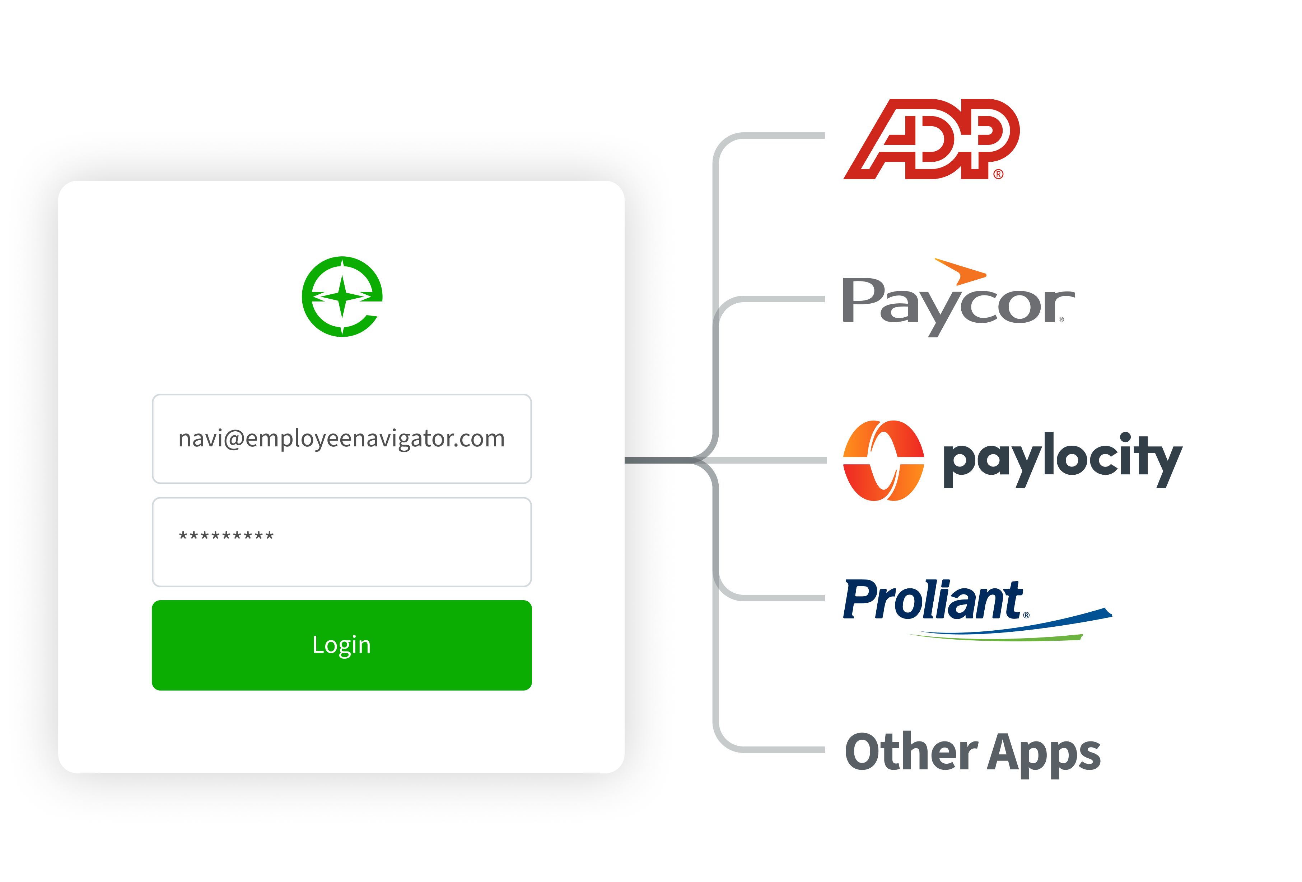
Payroll Integrations: Single Sign-On (SSO)
Single Sign-On (SSO) functionality allows your employees to seamlessly log in to Employee Navigator, without a username or password when they access the SSO within their self-service portal in Payroll.

Slide 7

Streamline Employee Management
01.
Know instantly when enrollment events occur to minimize claim & billing issues
Employee Self-Service
02.
Easy-to-use self-service portal puts employees in the driver’s seat
Enhance Communication
03.
Whether it’s benefits, compliance, or company communications, employees are always in the loop
Centralized HR
Online Employee Directory
04.
Keep your entire team connected

Slide 8
01.
Paperless
Paper forms and files are replaced by a centralized HR management system and employee portal that’s always up to date.
02.
Efficient
Manage everything from a single place so you can spend more time growing your business and less busywork
03.
Accessible
Help your employees help themselves by giving them the means to find what they need when they need it
Modernized HR
04.
Customizable
Go beyond the basics and drive engagement with quick access to reports and configuration tools

Slide 9
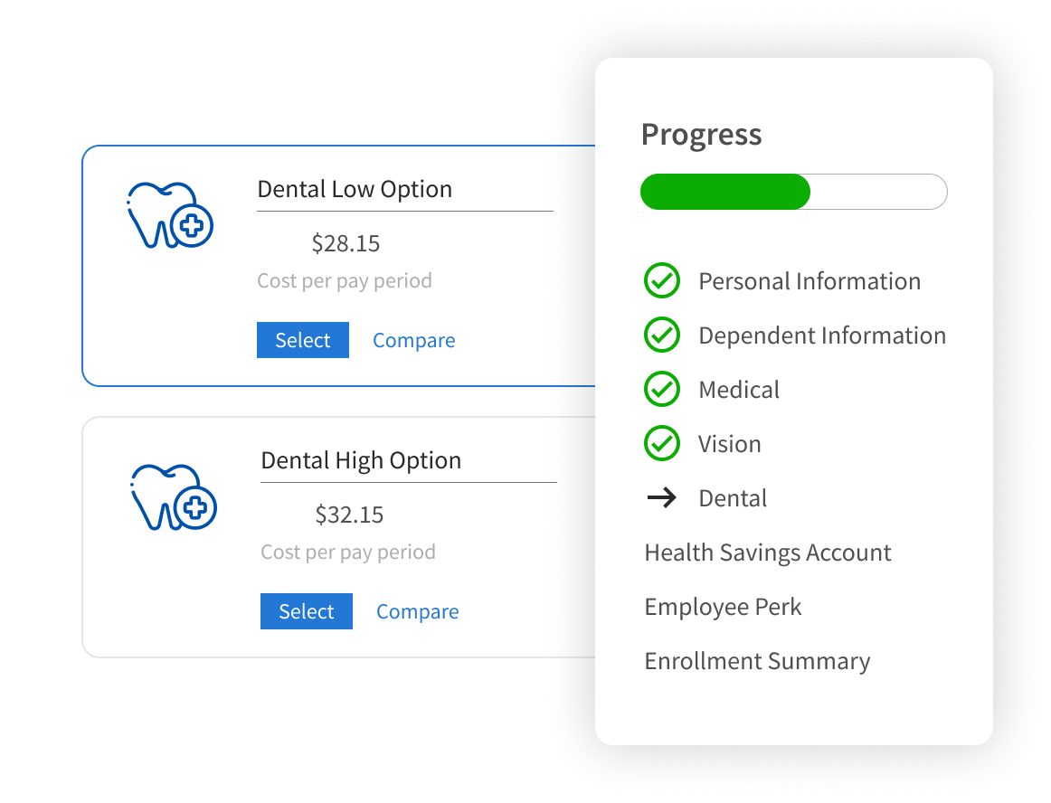
Give your new hires a great first day, not a stack of paperwork
Make benefits enrollment simple and confident
Employees get a guided experience with clear plan details, side-by-side comparisons, and built-in decision support.
Give new hires a great first day, not a stack of paperwork
Ditch paper forms and spreadsheets for a seamless, digital onboarding experience.
Collect everything you need, effortlessly
Gather new-hire information and compliance documents directly from employees so they can move straight into benefits enrollment.

Slide 10
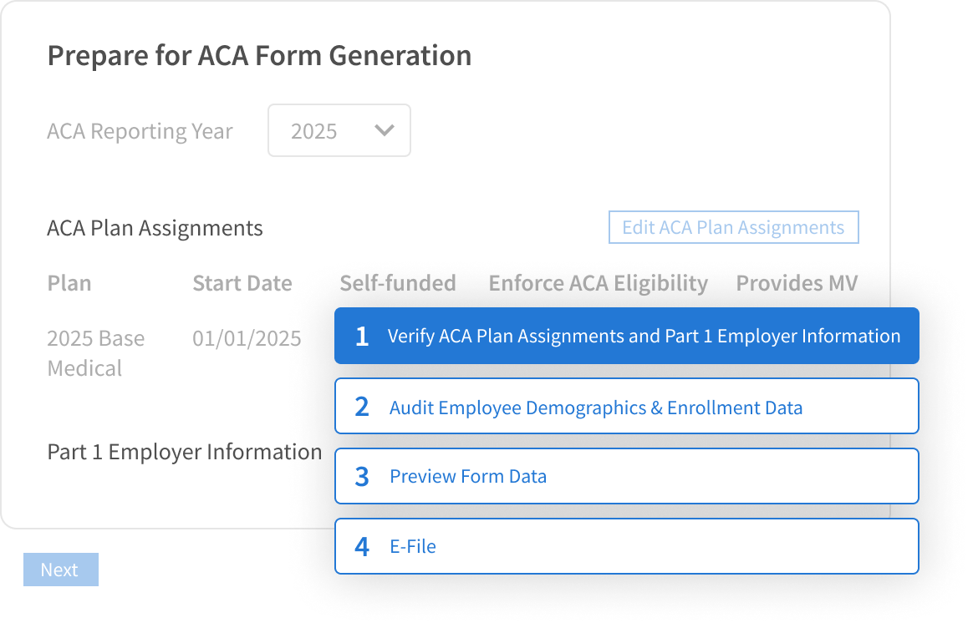
Stay compliant year-round with simple & powerful ACA Reporting tools
  Employee Navigator has built a set of simple, yet powerful, tools to make ACA compliance easier for you.
  Employee Navigator ensures coverage offered meets government guidelines, send required notifications, and generate IRS forms.
Notes:
Update the year on image

Slide 11
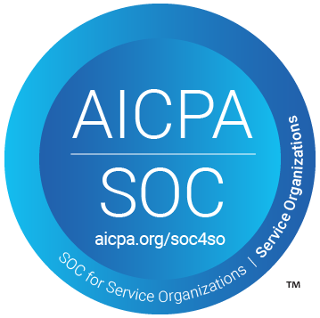



Employee Navigator invests heavily in security
SOC 2 Type II
HITRUST
HIPAA HITECH
GDPR (European Union)
New York Regulations (the toughest in the US)
2 Factor Authentication

Slide 12
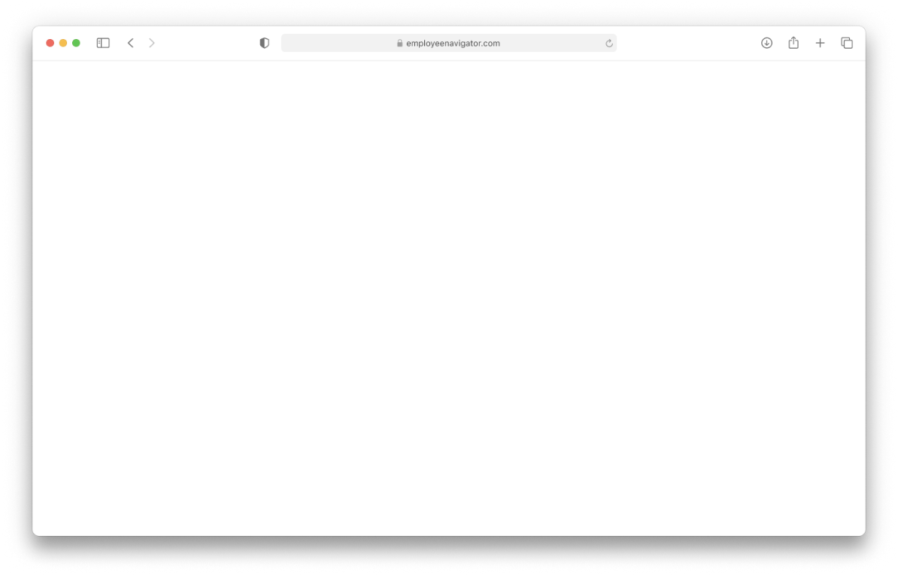
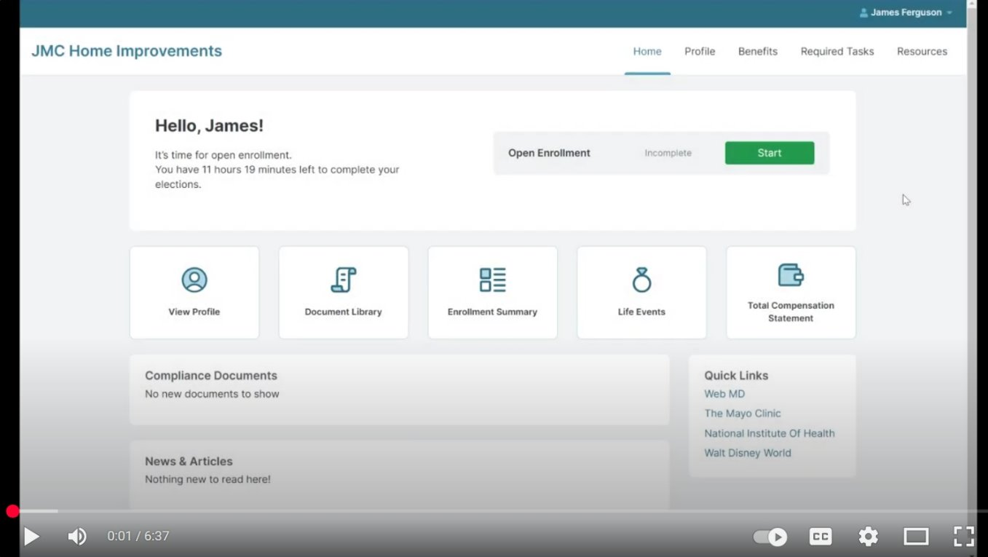
Video: The Employee Enrollment Experience
Video Link Here

Slide 13

Insert company logo
You’re ready for online enrollment
To get started, ask your broker about Employee Navigator or learn more at www.employeenavigator.com.

